Slide 1

THE CULTURAL LAYER
CHAPTER 06
‹#›

Slide 2
Topics
Going Beyond Play
Cultural Mechanics
Cultural Aesthetics
Cultural Narrative
Authorized Transmedia
Cultural Technology
Cultural Impact
‹#›

Slide 3
Going Beyond Play
What happens after the game?
Does it affect the players?
Does it affect society?
How have games affected your life?
How have you affected or changed games?
The Cultural Layer explores all of the aspects of a game that exist beyond play
The Cultural Layer exists at the intersection of the community of players of a game & society in general
Covers both the affect of the game on society and the affect of society on a game
Players have more agency than the game's developers
‹#›

Slide 4
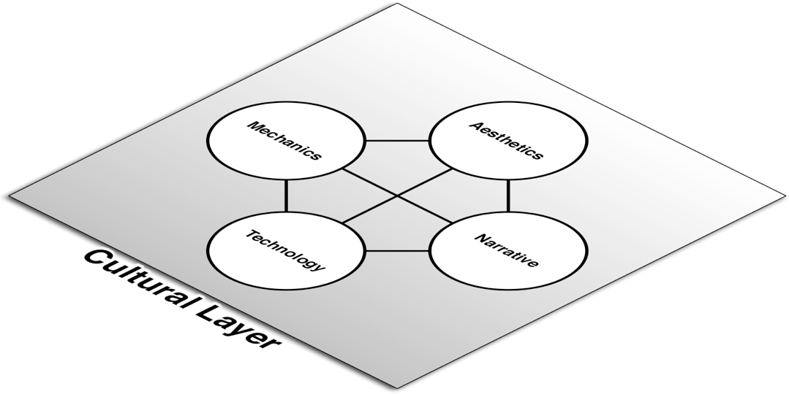


The Cultural Layer
Society
Communities
Players
Divisions between the four elements (MANT) are less distinct in the cultural layer
‹#›

Slide 5
The Cultural Layer: Mechanics
Cultural Mechanics occur when players take ownership over game mechanics
Game Mods
Players repurpose a game with their own mechanics
Examples:
Creating DotA from Warcraft III
Using the Creation Kit in Skyrim to create new characters and quests
Custom Game Levels
One of the most common cultural mechanics
Players create their own levels on which to play a game
Very common for FPS games: Quake, Doom, and Unreal
Games like Little Big Planet and Sound Shapes rely on players to expand their level offerings
‹#›

Slide 6
The Cultural Layer: Mechanics
Differs from "house rules" (which are Dynamic Mechanics)
In Cultural Mechanics, players significantly alter the original Inscribed Mechanics of a game
Cultural Mechanics also cover instances where game mechanics affect normal life
Have the actions you've taken while playing a game ever bled into normal life?
Examples:
Losing friends over games of Diplomacy or Risk
Being more aware of your environment and surroundings after playing an intense FPS
Being aware of how conspicuous you are after playing a stealth game
Looking for fun ways to climb buildings (especially Catholic churches) after playing Assassin's Creed
‹#›

Slide 7
The Cultural Layer: Aesthetics
Cultural Aesthetics occur when the community of players of a game makes their own art
Game Art – Players create new art to replace the existing art in a game
Fan Art – Fans of the game create art outside of the game that was inspired by it
Cosplay - A specific kind of fan art where the fan dresses as a character from the game
Cultural Aesthetics also covers gameplay itself as an art
The elegant play of a highly-skilled player can be seen as art
Making game designers similar to crafters of instruments
‹#›

Slide 8
The Cultural Layer: Narrative
Players take control and make their own game stories
Fan Fiction – Fans of the game create narrative outside of the game that was inspired by it
Narrative Game Mods – Fans create their own stories within the game
Examples:
Mike Hoye changed The Legend of Zelda: The Windwaker to refer to Link as "she" for his daughter
Players adding their own quests and stories to Fallout 3 or Skyrim
Machinima – Fans use a game engine to tell their own story
Example: Red vs. Blue, a comedy series shot inside Halo
‹#›

Slide 9
The Cultural Layer: Narrative
Cultural Narrative also covers the stories told by people and news media about games and gameplay
Examples:
New York Daily News – "What role might video game addiction have played in the Columbine shootings?"
A woman's story about how playing Journey with her dying father helped him come to terms with his impending death
Stop Teaching Our Kids to Kill by Lt. Col. Dave Grossman
How can you as a designer affect the stories told about games?
‹#›

Slide 10
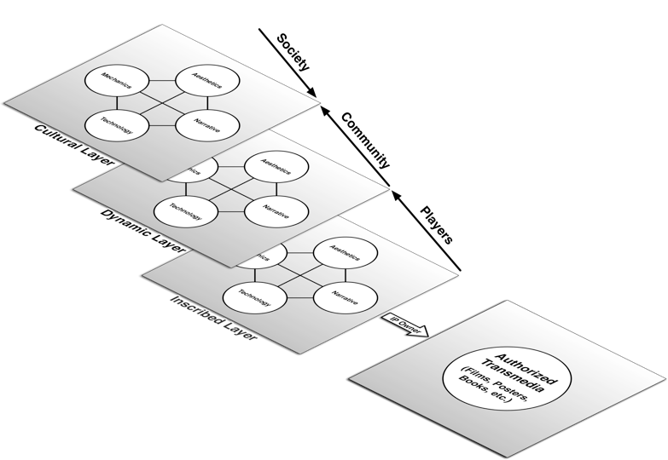
Authorized Transmedia ≠ Cultural Narrative
Authorized transmedia are NOT in the cultural layer
They are the Inscribed Layer of a new product made by the owners of the original game IP
‹#›

Slide 11
The Cultural Layer: Technology
Game technology used outside of games
Increases in visual fidelity of game technology have led to better graphics and framerates across many other fields
Real-time graphics are now used in everything from medical visualizations to previsualization of films
Player-made Game Tools
Players can make tools to help them play games
Examples:
Mapping applications for Minecraft
DPS (Damage Per Second) calculators for World of Warcraft
Aim Bots for FPS games like Unreal and Counter-Strike
Fan-made game guides like those at http://gamefaqs.com
‹#›

Slide 12
Cultural Impact
Acknowledging the positive and negative effects of gaming and gameplay
Positive:
Improved multi-tasking skills
Improved situational awareness
And several others
Negative
Game addiction
Desensitization to violence
And several others
‹#›

Slide 13
Cultural Impact
After Brown et al. v. Entertainment Merchants Association et al., games are now protected by the First Amendment
What will we do with that protection?
Prior to this ruling, the ESA (Entertainment Software Association) promoted studies that showed positive effects of gaming while downplaying studies that showed negative effects
As a protected medium will we now take more responsibility for those potential negative effects?
Or will we prey on people's weaknesses
As a result of Meguerian v. Apple Inc., Apple had to pay millions of dollars to families whose children had been tricked into paying excessive amounts of real money for in-game content
‹#›

Slide 14
Cultural Impact
What do you think?
‹#›

Slide 15
Chapter 6 – Summary
In the Cultural Layer, players and society have more agency than the original game developers
The Cultural Layer is defined by this shift in agency
Players take control by creating things like:
Fan art
Game mods
Machinema
Society has control of this layer by telling stories about games, possibly without having played them
This layer is the only one ever experienced by non-players
Be aware of the stories that may be told about your games
And plan for them
‹#›

Slide 16
Chapter 6 – Summary
Next Chapter: Acting Like a Designer
How do designers approach a problem?
What is the iterative process of design?
How do designers come up with new ideas?
‹#›

